Slide 1
Overview of Marketing Strategy

Slide 4
Marketing Strategy Framework
Identify market
opportunities
Customer
Company
Competition
Segmentation
Targeting
Positioning
Develop strategy and marketing programs to win
Product
Price
Promotion
Place

Slide 6
Customers

Slide 7
Customers
Who are your customers?
Market size and growth
Value to customers
Barriers to adoption

Slide 9
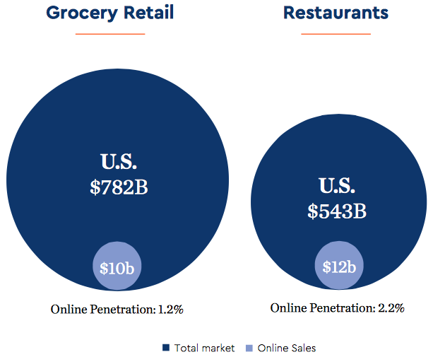
Blue Apron’s Market
Source: Blue Apron, May 2018 Investor Presentation

Slide 10
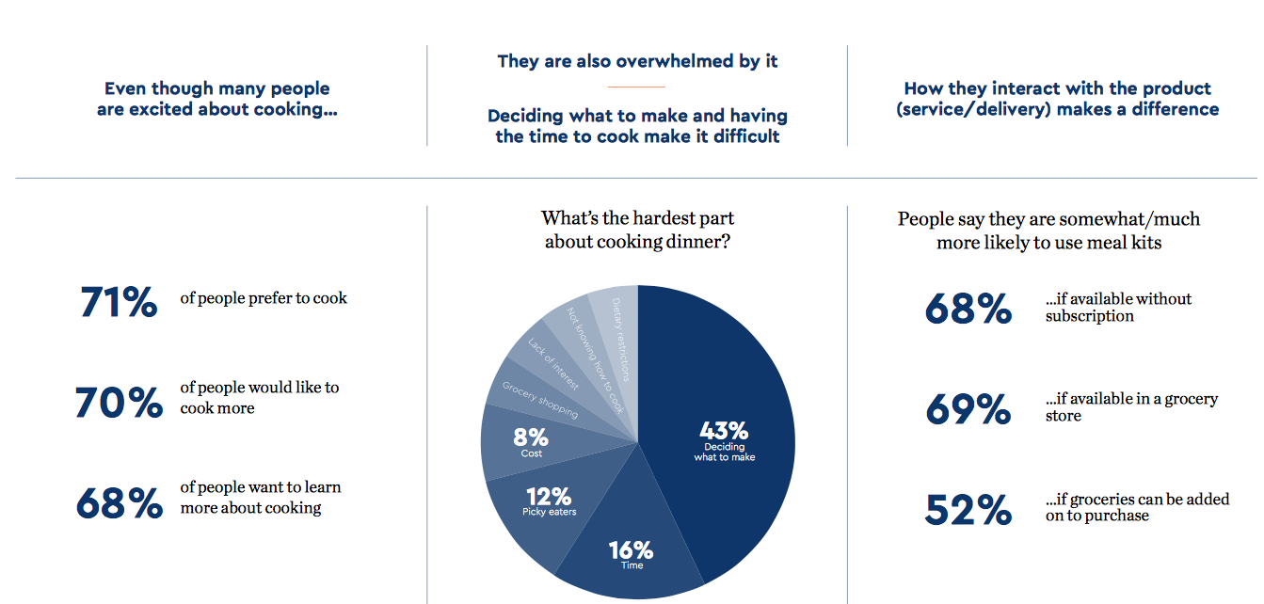
Blue Apron’s Customer Value
Source: Blue Apron, May 2018 Investor Presentation

Slide 12
Company

Slide 13
Company
Skills and capabilities
Profitability
Capital investment needed
Capability to scale

Slide 15
Blue Apron
Skills and capabilities: operational
Profitability: inventory, logistics, marketing
Capital investment needed: logistics, marketing
Capability to scale: unclear

Slide 17
Competition

Slide 18
Competition
Who are your competitors?
Their strengths and weaknesses
Competitive reaction

Slide 20
Blue Apron Competitors
Direct competitors
Indirect competitors
Grocery stores
Restaurants
Uber Eats

Slide 22
Segmentation–Targeting–Positioning (STP)

Slide 23
Marketing Strategy Framework
Identify market
opportunities
Customer
Company
Competition
Segmentation
Targeting
Positioning
Develop strategy and marketing programs to win
Product
Price
Promotion
Place

Slide 25
Segmentation

Slide 26
Segmentation
Why segment?
How to segment?
Why
Why do customers make the decision they do? Attitude/satisfaction/value propositions
What
What have customers done? Historical transactional information
Who
Who are customers? Firmographics/demographics

Slide 28




Segmenting the Dog Food Market
Segments
Attribute | Functionalist | Family Mutt | Baby Substitute | Nutritionist
Demo | Central/south Low income Children | East Low income Children | West High income No children | East/central High income Urban
Dogs | Several | One, average size | One, small | Several, large
Attitudes | No bother dog outdoor | Little interest | Attached dog fragile | High attachment
Feeding behavior | Basic feeders low priced | Heavy usage biscuits, lots of cans | Soft moist, high priced | Many feedings

Slide 30
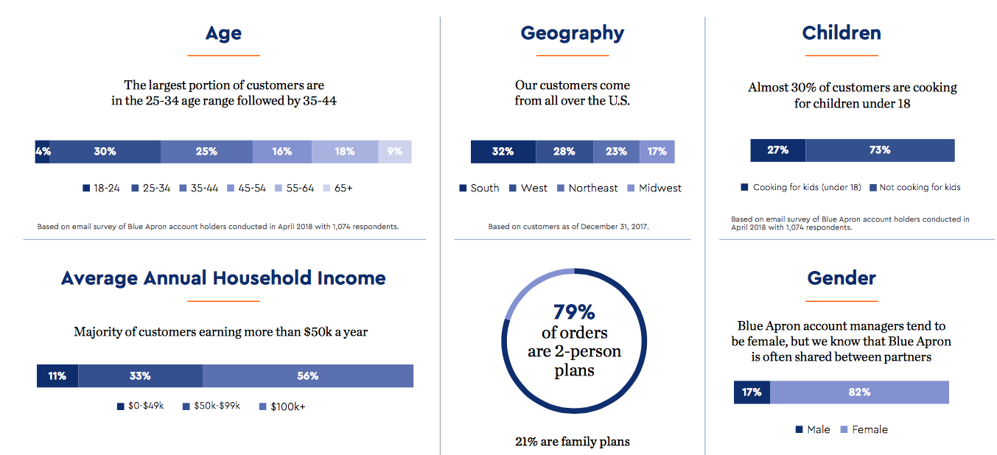
Blue Apron’s Customer Profile
Source: Blue Apron, May 2018 Investor Presentation

Slide 32
Targeting

Slide 33
Targeting
Market opportunities:
Segment size
Growth rate/potential
Target market selection
Competition:
Competitors’ strengths
Competitive intensity
Company “fit”
With objectives
With competencies
With customer base
With resources

Slide 35
Positioning

Slide 36
Positioning
Experiential
Economic
Functional

Slide 38
Blue Apron’s Positioning
Experiential
Fun of cooking
Economic
$10/dinner
Functional
Convenience, fresh

Slide 39
Marketing Strategy Framework
Identify market
opportunities
Customer
Company
Competition
Segmentation
Targeting
Positioning
Develop strategy and marketing programs to win
Product
Price
Promotion
Place

Slide 41
The Four Ps
Product

Slide 42
Product
Product line
Branding
Bundling
Product design

Slide 45
The Four Ps
Pricing

Slide 46
Pricing
Setting price
Dynamic pricing
Price plans

Slide 47
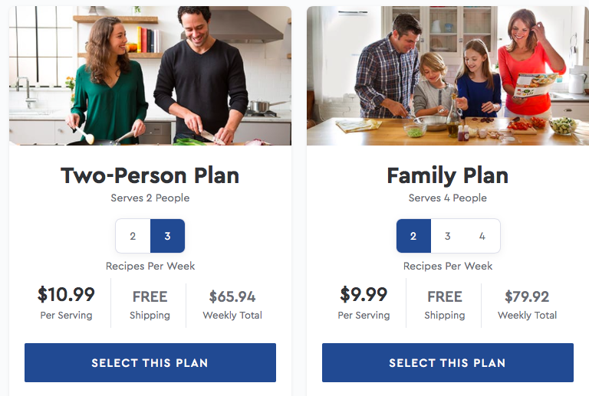
Blue Apron’s Pricing Plans
Source: Company website, May 2018

Slide 49
The Four Ps
Promotion

Slide 50
Promotion
Budget
Media selection
Creative content
Social media
ROI
Customer acquisition and retention

Slide 51
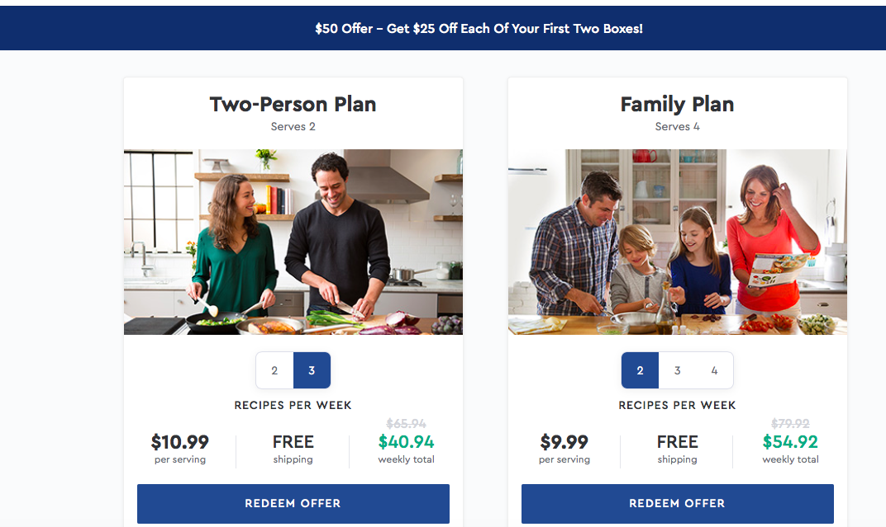
Blue Apron’s Promotional Offer
Source: Company website, May 2018

Slide 53
The Four Ps
Place

Slide 54
Place
Distribution channels
Omnichannel strategy
Sales force

Slide 55
Marketing Strategy Framework
Identify market
opportunities
Customer
Company
Competition
Segmentation
Targeting
Positioning
Develop strategy and marketing programs to win
Product
Price
Promotion
Place

